Slide 1

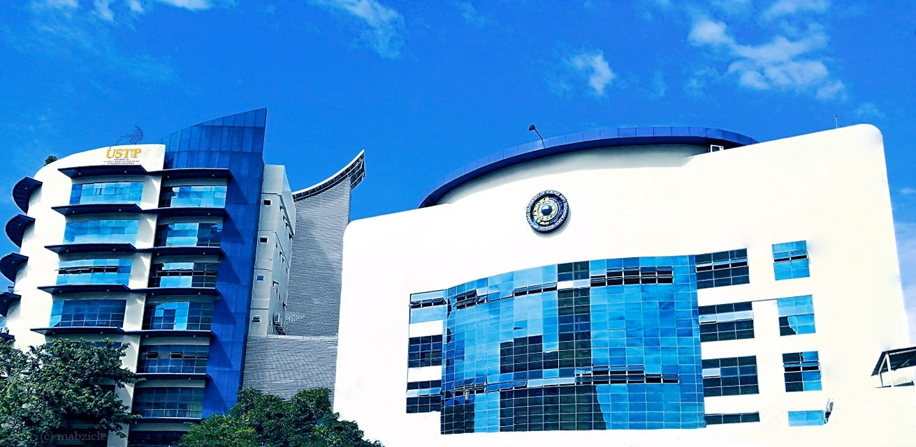




UNIVERSITY OF SCIENCE AND TECHNOLOGY
OF SOUTHERN PHILIPPINES
Alubijid | Balubal | Cagayan de Oro | Claveria | Jasaan | Oroquieta | Panaon | Villanueva
Manufacturing / Industrial Firm
Enterprise Security and Incident Response for Titan Manufacturing Corporation (TMC)

Slide 2


Introduction
Overview of the project
Scope: IT & OT security, cryptography, risk management
Goal: Protect manufacturing operations using real-world frameworks
UNIVERSITY OF SCIENCE AND TECHNOLOGY
OF SOUTHERN PHILIPPINES
Alubijid | Balubal | Cagayan de Oro | Claveria | Jasaan | Oroquieta | Panaon | Villanueva

Slide 3
Company Profile
About Titan Manufacturing Corporation
Nature of business: industrial/manufacturing
IT & OT environment overview
Key departments involved
UNIVERSITY OF SCIENCE AND TECHNOLOGY
OF SOUTHERN PHILIPPINES
Alubijid | Balubal | Cagayan de Oro | Claveria | Jasaan | Oroquieta | Panaon | Villanueva

Slide 4
Asset Inventory
Asset categories:
    IT Assets (servers, ERP, networks)
    OT Assets (SCADA, PLCs, sensors)
    Data & software assets
Importance: identifying what must be protected
Link to NIST CSF "Identify"
UNIVERSITY OF SCIENCE AND TECHNOLOGY
OF SOUTHERN PHILIPPINES
Alubijid | Balubal | Cagayan de Oro | Claveria | Jasaan | Oroquieta | Panaon | Villanueva

Slide 5
Threat & Vulnerability Assessment
Top threats: ransomware, insider threats, network intrusion
Key vulnerabilities: outdated OT systems, weak access control
Methodology:
    NIST SP 800-30
    ISO/IEC 27005
Risk Matrix (High/Medium/Low)
UNIVERSITY OF SCIENCE AND TECHNOLOGY
OF SOUTHERN PHILIPPINES
Alubijid | Balubal | Cagayan de Oro | Claveria | Jasaan | Oroquieta | Panaon | Villanueva

Slide 6
Cryptography & Authentication Demo
Purpose: secure OT → IT data transfer
Features:
    AES-256 GCM encryption
    RBAC (Admin, Analyst, OT Operator, Compliance, CISO)
    Excel validation before encryption
    Audit & incident logging
Technologies: Java/Spring Boot, AES-GCM, BCrypt, CSRF, Postgres
UNIVERSITY OF SCIENCE AND TECHNOLOGY
OF SOUTHERN PHILIPPINES
Alubijid | Balubal | Cagayan de Oro | Claveria | Jasaan | Oroquieta | Panaon | Villanueva

Slide 7
Security Controls Plan
Aligned with:
  NIST CSF (Protect/Detect/Respond/Recover)
  ISO/IEC 27001 controls:
      A.5 Policies
      A.9 Access Control
      A.10 Cryptography
      A.12 Operations
      A.16 Incident Management
Controls Implemented:
  MFA, Encryption, Firewalls, IDS/IPS
  Separation of IT & OT networks
  Logging & continuous monitoring
UNIVERSITY OF SCIENCE AND TECHNOLOGY
OF SOUTHERN PHILIPPINES
Alubijid | Balubal | Cagayan de Oro | Claveria | Jasaan | Oroquieta | Panaon | Villanueva

Slide 8
Legal & Ethical Compliance
Compliance with:
  RA 10173 – Data Privacy Act
  RA 10175 – Cybercrime Prevention Act
  RA 8792 – E-Commerce Act
  RA 10844 – DICT Act
  GDPR (best practice)
  ISO 27001, ISO 27701
Ensures confidentiality, integrity, availability, and lawful data processing.
UNIVERSITY OF SCIENCE AND TECHNOLOGY
OF SOUTHERN PHILIPPINES
Alubijid | Balubal | Cagayan de Oro | Claveria | Jasaan | Oroquieta | Panaon | Villanueva

Slide 9
Incident Handling & Reporting Plan
Based on NIST SP 800-61:
  Preparation
  Detection & Analysis
  Containment
  Eradication
  Recovery
  Lessons Learned
Includes:
  Escalation workflow
  Forensics-ready logging
  Communication procedures
UNIVERSITY OF SCIENCE AND TECHNOLOGY
OF SOUTHERN PHILIPPINES
Alubijid | Balubal | Cagayan de Oro | Claveria | Jasaan | Oroquieta | Panaon | Villanueva

Slide 10
Business Impact Analysis (BIA)
Critical functions identified
Impact categories: financial, operational, reputational
Recovery metrics:
    RTO (Recovery Time Objective)
    RPO (Recovery Point Objective)
Alignment with ISO 22301
UNIVERSITY OF SCIENCE AND TECHNOLOGY
OF SOUTHERN PHILIPPINES
Alubijid | Balubal | Cagayan de Oro | Claveria | Jasaan | Oroquieta | Panaon | Villanueva

Slide 11
Key Findings
Strong need for encryption & data governance
OT–IT convergence increases risk
Lack of centralized security monitoring
Policies require alignment with global frameworks
UNIVERSITY OF SCIENCE AND TECHNOLOGY
OF SOUTHERN PHILIPPINES
Alubijid | Balubal | Cagayan de Oro | Claveria | Jasaan | Oroquieta | Panaon | Villanueva

Slide 12
Recommendations
Implement full ISMS (ISO/IEC 27001 certification)
Deploy SIEM for real-time threat detection
Enforce MFA across all critical systems
Regular compliance audits (NPC, ISO)
Strengthen OT network segmentation
Continuous employee security awareness training
UNIVERSITY OF SCIENCE AND TECHNOLOGY
OF SOUTHERN PHILIPPINES
Alubijid | Balubal | Cagayan de Oro | Claveria | Jasaan | Oroquieta | Panaon | Villanueva

Slide 13
System Demo Summary
Real encryption (AES-GCM 256)
Authentication & RBAC
Assignment-based access control
Comprehensive audit & incident logs
Simulated OT-to-IT secure data handling
UNIVERSITY OF SCIENCE AND TECHNOLOGY
OF SOUTHERN PHILIPPINES
Alubijid | Balubal | Cagayan de Oro | Claveria | Jasaan | Oroquieta | Panaon | Villanueva

Slide 14
Conclusion
TMC’s cybersecurity posture significantly strengthened
Risks identified and addressed using global standards
Secure data processing demonstrated with working system
Project aligns with real-world industrial cybersecurity requirements
UNIVERSITY OF SCIENCE AND TECHNOLOGY
OF SOUTHERN PHILIPPINES
Alubijid | Balubal | Cagayan de Oro | Claveria | Jasaan | Oroquieta | Panaon | Villanueva

Slide 15
Thank You / Q&A
Open floor for questions
“Prepared to discuss technical, legal, and operational aspects.”
UNIVERSITY OF SCIENCE AND TECHNOLOGY
OF SOUTHERN PHILIPPINES
Alubijid | Balubal | Cagayan de Oro | Claveria | Jasaan | Oroquieta | Panaon | Villanueva

